Slide 1
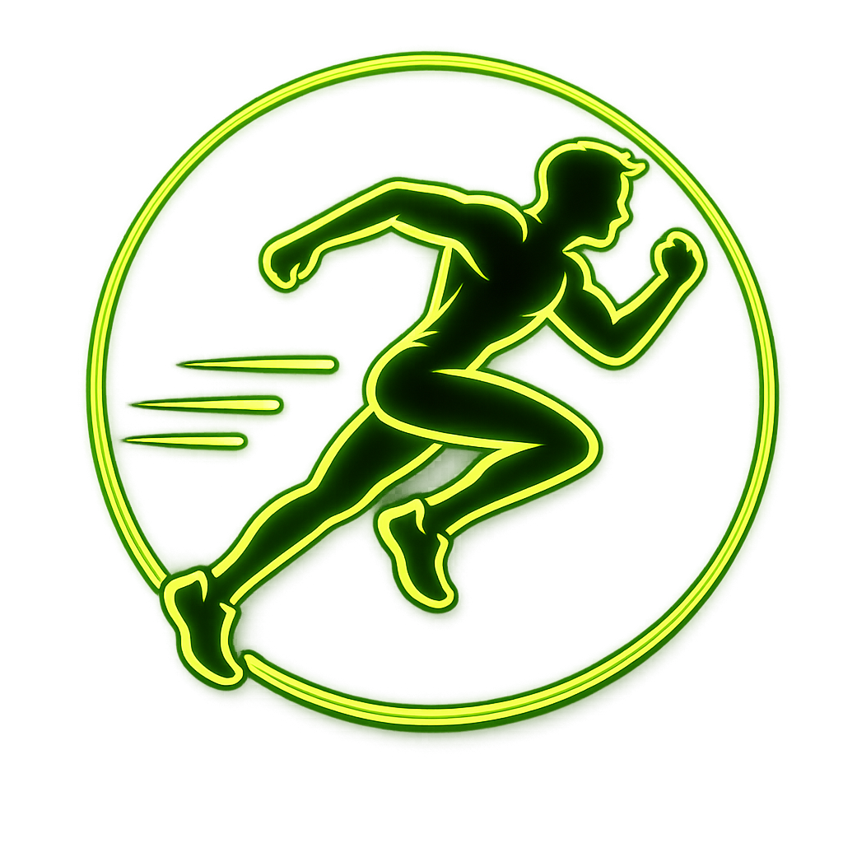
AI • COMPUTER VISION • SPORTS BIOMECHANICS
Sports Injury
Risk Detection
AI-Powered Biomechanical Motion Analysis & Real-Time Injury Prevention
Biomechanical Analysis at the Edge
In-browser MediaPipe WebAssembly (WASM) pose estimation eliminating heavy server video uploads.
Proactive Predictive Safety
Real-time dynamic joint scanning (valgus, pelvic tilt, flexion) to catch biomechanical anomalies pre-injury.
Explainable Clinical Support
Transparent XAI rationale attribution cards paired with Google Gemini AI corrective exercise plans.
Presented by:
Iqra Khan
Sports Injury Risk Detection System (SIRD) • Final Capstone Presentation

Slide 2
Problem Statement & Key Challenges
02
Bridging the gap between subjective athletic screening and real-world computer vision constraints
TRADITIONAL SPORTS INJURY SCREENING GAPS
• Subjective Visual Inspections
Coaches and athletic staff rely heavily on visual observation. Subtle dynamic knee valgus collapses (<15°) or eccentric bilateral asymmetries during high-speed loading are virtually invisible to the naked human eye.
• Post-Injury Reactive Diagnostics
Conventional sports medicine operates reactively—diagnosing ligament tears or structural muscle damage after traumatic failure has occurred, rather than flagging cumulative biomechanical risk.
• Prohibitive Laboratory Barriers
Gold-standard 3D optical motion capture laboratories and force plate platforms cost upwards of $50,000+, demanding complex multi-camera rigs and specialized operators inaccessible to local clubs and schools.
EDGE COMPUTER VISION & TECHNICAL CHALLENGES
• 1. Camera Occlusion & Complex Angles
Single-camera feeds suffer from limb self-occlusion during rapid multi-planar movements, corrupting depth estimations and 3D angle calculations.
• 2. Coordinate Jitter & Noise Spikes
Pixel-level tracking micro-fluctuations create artificial velocity spikes, triggering false-positive alerts when computing derivative acceleration.
• 3. Clothing & Outdoor Lighting Interference
Loose athletic apparel and variable outdoor lighting (shadows, direct sunlight) obscure true anatomical joint centers and skeletal keypoints.
• 4. Diverse Anthropometry & Frame Rate Drops
Athletes vary widely in height, limb ratios, and pelvic widths; additionally, mobile CPU thermal throttling causes fluctuating video FPS that disrupt time-series mechanics.
⚠️ Impact: Over 60% of non-contact ACL & tendon injuries stem from unmonitored biomechanical defects
🎯 Goal: Robust client-side normalization, heuristic smoothing & adaptive anthropometry filters

Slide 3
Project Objectives & Core Vision
03
Designing an automated, accessible, zero-latency clinical intelligence ecosystem
01 • Shift from Reactive to Predictive Prevention
Replace subjective trainer observation and post-injury treatments with automated, real-time predictions of biomechanical risk before actual musculoskeletal damage occurs.
Key Focus: Continuous scanning of dynamic knee valgus, pelvic tilt, and trunk lean during natural functional movement.
02 • Eliminate Video Latency & Server Overhead
Offload all 33-point skeletal landmark detection directly to the user's browser using lightweight Google MediaPipe WebAssembly (WASM).
Key Focus: Eliminates heavy multi-gigabyte video uploads, keeps cloud RAM usage below 30MB, and permanently avoids SIGKILL server crashes.
⚡ Real-Time Continuous Screening
🚀 <30MB Cloud RAM • Zero Video Uploads
03 • Centralize Multi-Role Athletic Workspaces
Provide athletes, coaches, and clinicians with a single unified workspace containing live telemetry, joint risk heatmaps, and downloadable clinical summaries.
Key Focus: Custom-tailored views: Athlete portal (heatmaps & drills), Coach dashboard (roster triage & alerts), and Physiotherapist view (telemetry).
04 • Automate Safe Generative AI Prescriptions
Instantly translate predicted motion defects and kinetic anomalies into safe, personalized corrective exercise routines powered by Google Gemini.
Key Focus: Embedded deterministic clinical safety guardrails ensure exercises directly strengthen vulnerable stabilizing muscle groups.
👥 Unified Multi-Tenant Role Access
🧠 Deterministic Safety Guardrails

Slide 4
Existing Limitations vs. Proposed Solution
04
Benchmarking traditional motion analysis methods against the SIRD edge-computed ecosystem
TRADITIONAL APPROACHES & LIMITATIONS
• Wearable IMU Sensor Suits: Restrict natural movement, require frequent manual sensor calibration, and cost thousands of dollars. Unfeasible for daily squad training.
• Optical Motion Capture Labs: Require multi-camera synchronized studio rigs ($50,000+). Inaccessible to grassroots athletics, schools, and local sports clubs.
• Static Rule Spreadsheets: Coaching checklists fail to evaluate dynamic multi-planar posture variables, angular velocity changes, and fatigue degradation in real time.
• High Hardware & Cost Barrier: Elite institutes monopolize diagnostic tools while amateur athletes remain vulnerable to preventable injuries.
• Black-Box ML & Server Bottlenecks: Legacy ML models output raw, unexplainable risk scores without clinical reasoning. Processing raw video on backend servers leads to severe SIGKILL gateway crashes.
THE SIRD PLATFORM ADVANTAGE
• Client-Side WASM Tracking: MediaPipe WebAssembly executes skeletal landmark calculations directly in the athlete's web browser, cutting server processing load to zero and guaranteeing zero-lag video scanning.
• Lightweight JSON Telemetry Bypass: Instead of uploading gigabyte video streams to servers, only 33 joint angle coordinates (<10 KB) are transmitted to the backend API.
• Explainable AI (XAI) Attribution: Translates Random Forest decision trees into transparent clinical rationales (e.g., 'ACL sprain risk driven by 14.2° dynamic knee valgus and stiff landing <30°').
• Dedicated Multi-Role Workspaces: Custom-tailored dashboard interfaces for Athletes (prescriptions & heatmaps), Coaches (roster triage & alerts), and Physiotherapists (longitudinal kinematics).
• Generative AI Prescription Agent: Google Gemini LLM synthesizes fully personalized, adaptive corrective exercise routines with deterministic safety guardrails tailored to the athlete's sport and role.
❌ Legacy Dilemma: Fragile hardware, prohibitive cost ($50k+), and uninterpretable black-box models
✅ SIRD Solution: Zero hardware cost, 100% browser edge compute, explainable AI & Gemini recovery

Slide 5
System Architecture & Data Pipeline
05
Decoupled 3-tier pipeline routing video from local edge to clinical intelligence
TIER 1 • CLIENT EDGE
React.js + MediaPipe WASM
Captures video and extracts 33 3D skeletal joints locally in-browser.
• HTML5 Capture & Viewfinder
Ingests live webcam or uploaded MP4 drills locally.
• MediaPipe Tasks Vision WASM
Computes 33 skeletal joint coordinates at 25+ FPS.
• In-Browser Kinematic Math
Calculates knee valgus, pelvic tilt, and torso lean.
• Zero Video Server Uploads
Cuts server bandwidth to zero and protects athlete privacy.
TIER 2 • TELEMETRY API
FastAPI + MongoDB Atlas
Routes compact JSON telemetry payloads asynchronously with sub-second speed.
• Lightweight JSON Payload
Transmits compact joint telemetry (<10 KB) instead of video files.
• FastAPI Asynchronous Gateway
Handles request routing and validation in under 0.5s.
• MongoDB Atlas & Motor Async
Persists athlete profiles, telemetry records, and alerts.
• Live Event Alert Bus
Dispatches dynamic 200ms anomaly notifications to coach dashboards.
TIER 3 • AI INTELLIGENCE
ML Ensemble + Gemini LLM
Predicts multi-joint injury risks and synthesizes personalized recovery plans.
• 6-Model Random Forest Ensemble
Evaluates ACL, hamstring, ankle, shoulder, and back risks.
• Isolation Forest Anomaly Engine
Unsupervised detector flags biomechanical movement breakdowns.
• Google Gemini Prescription Agent
Generates safe, structured corrective exercise regimens.
• ReportLab PDF Exporter
Generates one-click medical summary reports and CSV logs.
⚡ 25+ FPS Edge Compute • 0ms Upload
📦 <10 KB JSON • <0.5s API Latency
🎯 94.2% Accuracy • Automated PDF Reports

Slide 6
Machine Learning & Risk Scoring Methodology
06
Hybrid ensemble architecture combining supervised classification, anomaly detection, and clinical weighting
1. RANDOM FOREST ENSEMBLE CLASSIFIERS
• 6 Targeted Vulnerability Classifiers: Predicts specific injury risks: ACL tear, Hamstring strain, Ankle sprain, Shoulder impingement, Lumbar back pain, and Overuse injury.
• 10,000+ Kinematic Data Points: Models trained and cross-validated across high-velocity athletic movements with rigorous kinematic feature extraction.
• Explainable Threshold Bounds: Maps clinical criteria: Dynamic knee valgus >15° flags critical ACL risk; stiff landing flexion <30° indicates shock absorption failure.
2. UNSUPERVISED ISOLATION FOREST ANOMALY ENGINE
• Unsupervised Outlier Detection: Detects atypical motion signatures and technique breakdowns without requiring pre-labeled injury incident samples.
• Kinetic Form Collapse Detection: Flags sudden form collapse, excessive torso lean, unilateral loading bias, and erratic joint deceleration spikes.
• Real-Time Confidence Scoring: Outputs an anomaly contamination score (0.0 to 1.0) dynamically informing topbar alerts and urgent coach notifications.
3. HOLISTIC 5-FACTOR CLINICAL RISK SCORING FORMULA
Overall Injury Risk = 35%(Biomechanics) + 20%(Injury History) + 20%(Asymmetry) + 15%(Workload) + 10%(Fatigue)
• 35% Live Biomechanics: Dynamic joint angles, angular velocities, valgus collapse, and landing mechanics extracted from video.
• 20% Injury History: Past medical records, prior ligament tears, joint surgeries, and recurrence vulnerabilities.
• 20% Bilateral Asymmetry: Differential loading between left and right limbs during unilateral planting and bilateral landing.
• 15% Acute-to-Chronic Load: Cumulative training volume, weekly session intensity, and sprint jump count metrics.
• 10% Athlete Fatigue Index: Session duration, perceived exertion metrics, and late-session kinetic deceleration degradation.

Slide 7
Technology Stack & Core Components
07
Modern, decoupled technologies built for client-side speed, resilience, and horizontal scalability
FRONTEND & EDGE
• React.js & Vite
High-performance reactive user interface shell with rapid hot module reloading and lightweight bundle footprint.
• HTML5 Canvas API
Draws live skeletal overlays, joint node coordinates, and kinematic vector lines at 25+ FPS.
• MediaPipe Tasks Vision WASM
Static CDN WebAssembly bundle calculating 33 3D skeletal landmarks locally in the browser.
• Tailwind CSS UI
Responsive, dark-themed clinical dashboard interface with role-tailored navigation.
BACKEND API CORE
• Python 3.11+ & FastAPI
Asynchronous high-throughput REST API routing telemetry, authentication, and clinical reports.
• Pydantic V2 Schemas
Strict typing and deterministic data validation for incoming joint angles and athlete profiles.
• Uvicorn ASGI Server
Ultra-fast asynchronous server engine handling concurrent requests without thread blocking.
• JWT Security
Role-based access tokens separating athlete, coach, and clinician authorization levels.
DATABASE & STORAGE
• MongoDB Atlas
Cloud NoSQL document store hosting athlete records, historical telemetry scans, and notifications.
• Motor Async Driver
Non-blocking asynchronous Python driver maintaining high throughput under concurrent load.
• Dynamic Schema Indexing
Rapid longitudinal query lookups across training dates, injury types, and squad rosters.
• Automated Cloud Backups
Secure, encrypted at rest, and highly available multi-region database clustering.
ML & GENERATIVE AI
• Scikit-Learn Classifiers
Trained Random Forest ensemble and Isolation Forest anomaly detection engines.
• Google Gemini LLM API
Generative AI agent synthesizing personalized, clinically safe corrective exercise routines.
• ReportLab Engine
Dynamic generator producing downloadable, professional PDF medical summaries on demand.
• NumPy & SciPy
Vectorized trigonometric angle calculations and kinematic data smoothing routines.
⚡ Zero Server Load • 25+ FPS
🚀 Async Non-Blocking Architecture
☁️ Scalable Cloud NoSQL Store
🧠 Hybrid Deterministic + GenAI

Slide 8
Project Demo & System Workflow
08
Four-phase end-to-end user experience and data lifecycle during a movement scan
PHASE 01
Motion Video Capture
Athlete or coach launches the HTML5 recording viewfinder or selects an existing athletic video file.
• Supports standard MP4/WebM uploads or live webcam recording.
• Focuses on functional movements: squats, jumps, landing drills, and sprints.
• Markerless capture: no wearable sensors, calibration suits, or lab gear needed.
PHASE 02
WASM Pose Extraction
Browser loops video frames and extracts 33 3D skeletal landmarks locally in WebAssembly.
• Client-side processing at 25+ FPS with live skeletal wireframe overlay.
• Computes real-time dynamic joint angles: knee valgus, pelvic tilt, torso lean.
• Visual progress bar tracks scan completion from 0% to 100% locally.
PHASE 03
Telemetry Processing
Micro JSON telemetry payload is posted to FastAPI backend for instant AI scoring.
• Random Forest ensemble scores ACL, hamstring, ankle, and shoulder risk in <0.5s.
• Isolation Forest scans for form collapses and biomechanical anomalies.
• Holistic 5-factor clinical formula computes overall athlete injury vulnerability.
PHASE 04
Prescription & Render
Google Gemini AI synthesizes corrective routines and dashboard populates instantly.
• Gemini agent outputs adaptive exercise prescriptions with clinical guardrails.
• Interactive joint risk heatmaps, XAI rationale cards, and alert badges render live.
• One-click export generates comprehensive medical PDF reports and CSV data.
📹 MP4 / Live Webcam Feed
🦴 33 Keypoints • 25+ FPS
⚡ <0.5s Multi-Model Scoring
📋 Heatmaps + Gemini Regimens

Slide 9
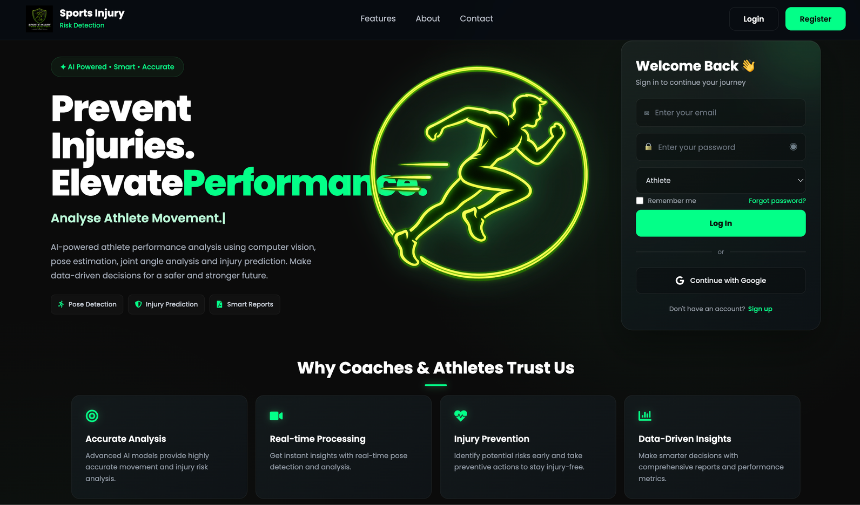
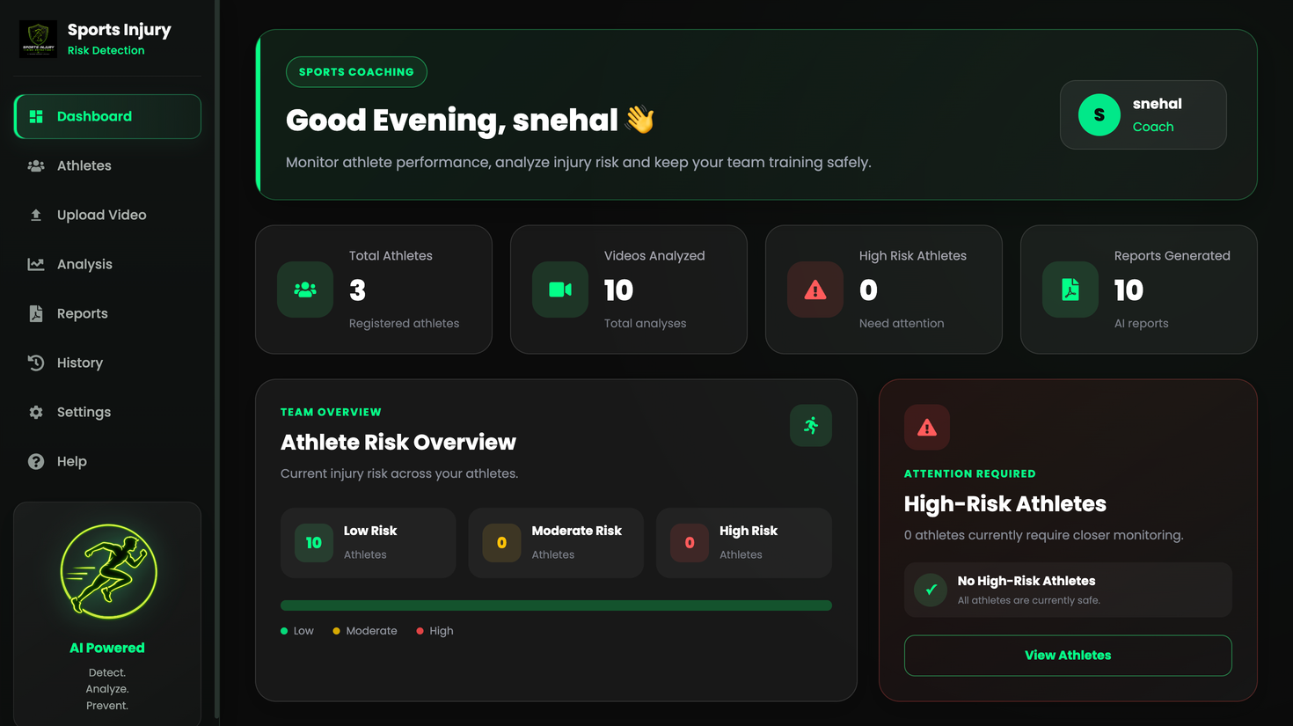
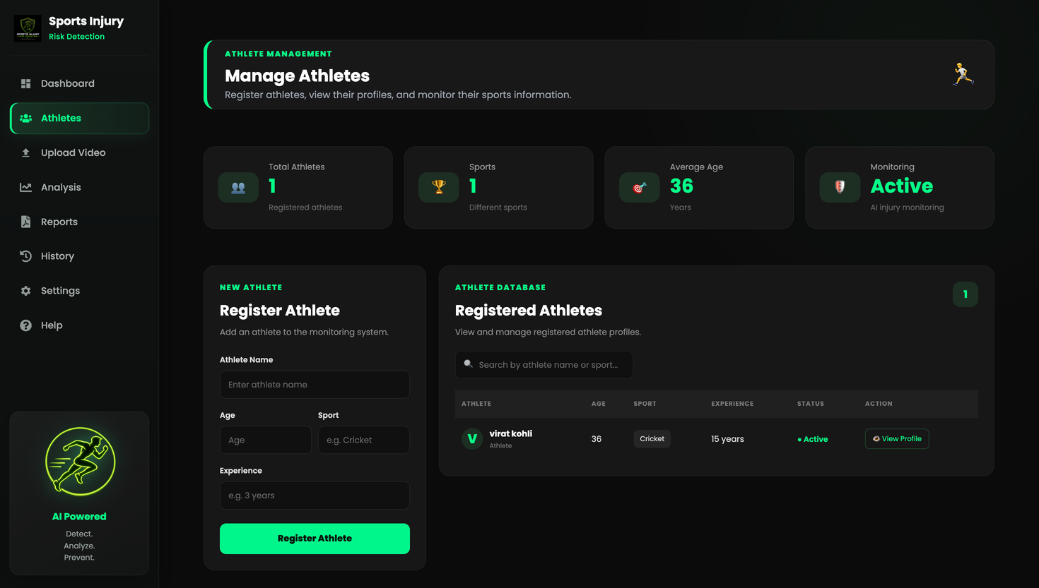
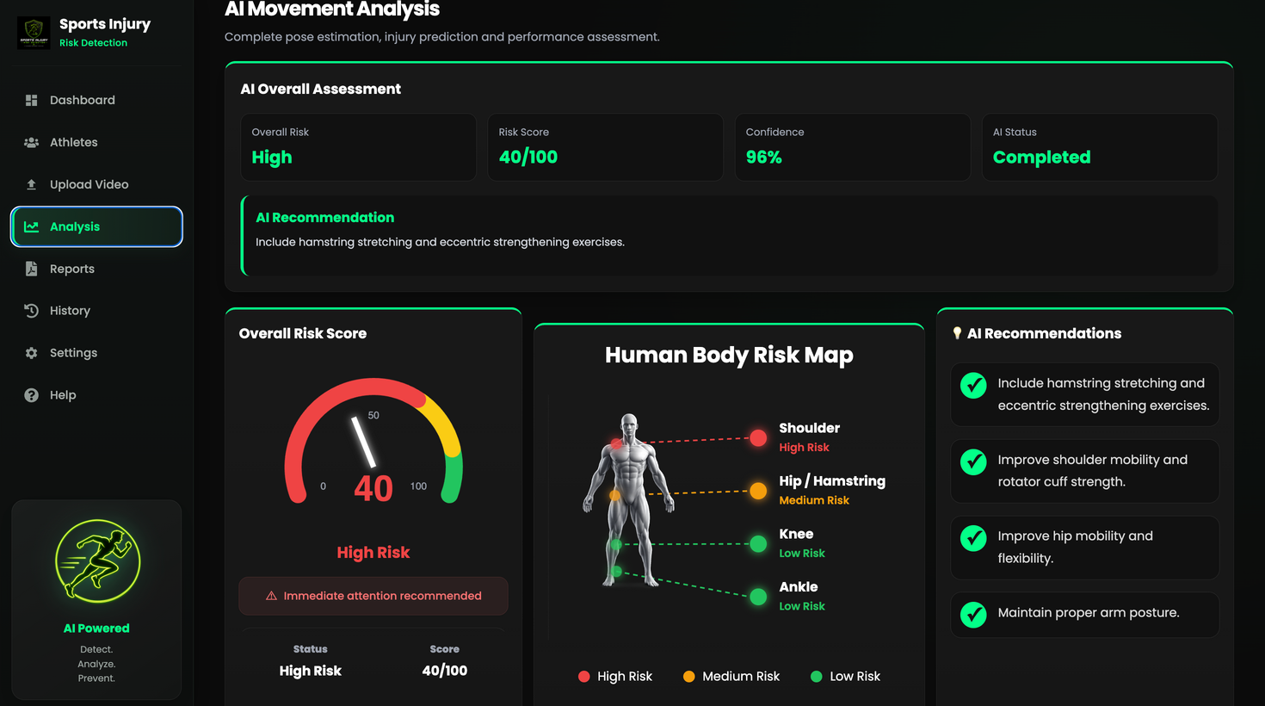
UI/UX Design & Dashboard Interface
09
Production application screens: Portal onboarding, coach triage, athlete profiles, and live telemetry
01. LANDING PAGE & PORTAL NAVIGATION
02. COACH & CLINICIAN DASHBOARD
03. ATHLETE MANAGEMENT & PROFILES
04. VIDEO UPLOAD & REAL-TIME TELEMETRY

Slide 10
Results, Operational Metrics & Future Scope
10
Model validation benchmarks, zero-crash operational reliability, and future clinical roadmap
MODEL ACCURACY & OPERATIONAL RELIABILITY
• 94.2% ACL Injury Risk Accuracy
Model trained on 10,000+ kinematic data rows predicts ACL tears and high-risk dynamic knee valgus collapses with high precision.
• 92.8% Hamstring Risk Accuracy
Accurately maps force imbalances, eccentric loading irregularities, and knee flexion loading anomalies during sprinting and cutting.
• Sub-Second API Response (<0.5s)
FastAPI executes multi-model ML inference and anomaly checks in under 0.5s via lightweight JSON telemetry bypass.
• Zero Server-Side SIGKILL Crashes
Bypassing server video decoding and running MediaPipe in-browser keeps cloud backend RAM permanently below 30MB.
• 200ms Notification & 1-Click Export
High-risk form breakdowns trigger dynamic alert badges in 200ms; instant one-click ReportLab PDF medical summaries and CSV logs.
FUTURE SCOPE & CLINICAL HORIZONS
• Multi-Modal Wearable Sensor Fusion
Integrate wearable IMU accelerometers and sEMG muscle activation sensor telemetry alongside computer vision coordinates for sub-millisecond dynamic tracking and impact estimation.
• Dynamic 3D Kinematic Avatar Rendering
Deploy interactive Three.js / WebGL dynamic skeletal avatars in the coach dashboard to visualize multi-planar joint stress vectors from 360-degree viewpoints.
• LSTM Predictive Recovery Modeling
Deploy deep learning time-series neural networks (LSTM/GRU) to forecast athlete rehabilitation recovery curves and compute return-to-play readiness indexes.
• Sport-Specific Biomechanical Modules
Expand kinematic rule bases for specialized sport disciplines: soccer cutting drills, basketball landing impacts, and cricket bowling mechanics.
Sports Injury Risk Detection System (SIRD) • Presented by Iqra Khan • Questions & Discussion
Empowering coaches, athletes, and physiotherapists with accessible, real-time edge biomechanics to predict injuries before they happen. Thank you!

